Slide 1
Ch.4 The Continuous-Time Fourier Transform
Representation of Aperiodic Signals: Continuous-Time Fourier Transform (Ch.4.1)
FT for Periodic Signals (Ch.4.2)
Properties of Continuous-Time FT (Ch.4.3)
The Convolution Property (Ch.4.4)
The Multiplication Property (Ch.4.5)
Tables of Fourier Transform Properties and of Basic FT Pairs (Ch.4.6)
Systems Characterized by Linear Constant-Coefficient Differential Equations (Ch.4.7)

Slide 2
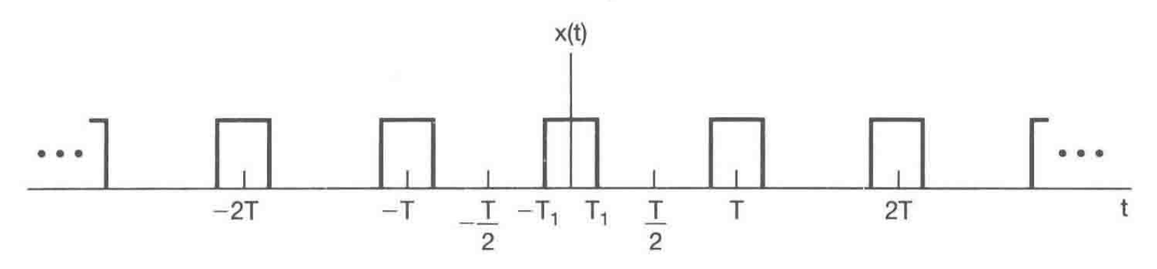
Frequency domain analysis: periodic in time
LTI system unit impulse response: h(t), aperiodic in time
How about frequency domain analysis for signals aperiodic in time?

Slide 3
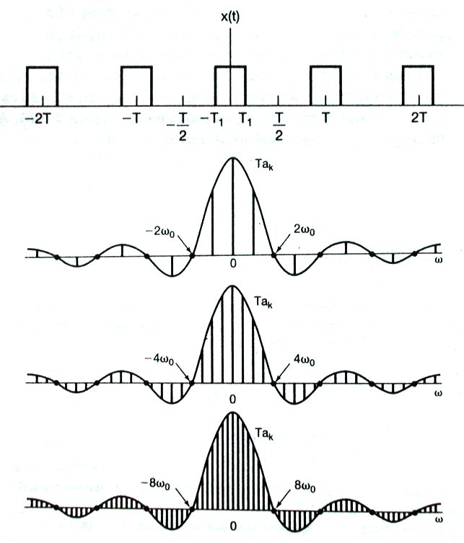
Fix pulse shape, increase period
the same frequency
T = 4T₁
T = 8T₁
the same envelope in frequency
T = 16T₁

Slide 4
1. Representation of Aperiodic Signals: Continuous-Time Fourier Transform
1). Development of the Fourier transform representation of an aperiodic signal
( Go from Fourier series to Fourier transform )
As T increases, we have two observations:
The harmonics are packed more and more closer to each other;
However, the shape (the envelope) of the spectrum remains the same (and it is determined by the pulse shape of the signal).

Slide 5
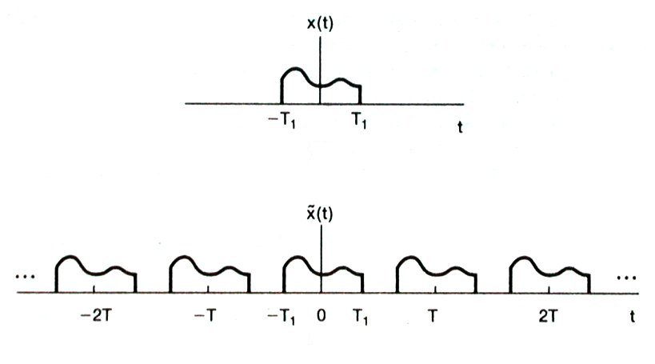
1. Representation of Aperiodic Signals: Continuous-Time Fourier Transform
(2) Go from periodic to aperiodic
Construct a periodic signal from the aperiodic signal x(t); later, let
No overlap in time

Slide 6
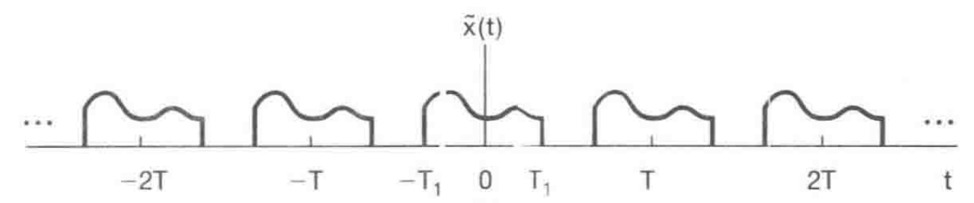
1. Representation of Aperiodic Signals: Continuous-Time Fourier Transform
For periodic signal , we have its Fourier series:
For aperiodic signal x(t) :
How to find a similar expression for the aperiodic signal?

Slide 7
1. Representation of Aperiodic Signals: Continuous-Time Fourier Transform
Define
then
Decompose the signal into combinations of exponentials

Slide 8
1. Representation of Aperiodic Signals: Continuous-Time Fourier Transform
Fourier transform:
or
The signal as a combination of complex exponentials, the same as FS with harmonics.
Either time-domain or frequency-domain and they are equivalent.
A signal has a unique spectrum and a spectrum is for a unique signal.

Slide 9
1. Representation of Aperiodic Signals: Continuous-Time Fourier Transform
About LTI system:
Unit impulse response:
System frequency response:
Either the time-domain or frequency-domain description can be used.

Slide 10
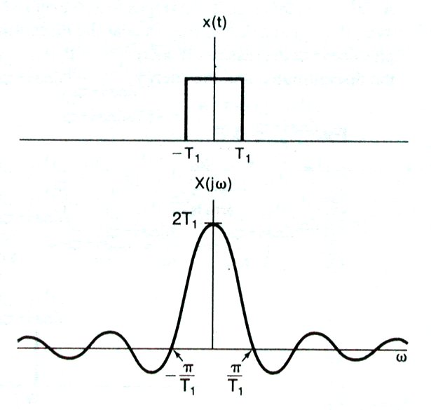
1. Representation of Aperiodic Signals: Continuous-Time Fourier Transform
Connection between the periodic and aperiodic signals:

Slide 11
1. Representation of Aperiodic Signals: Continuous-Time Fourier Transform
2). Convergence of Fourier transform
Dirichlet conditions:
(1) x(t) is absolutely integrable.
(2) x(t) has a finite number of maxima and minima within any finite interval.
(3) x(t) has a finite number of discontinuity within any finite interval. Furthermore, each of these discontinuities must be finite.
Note: if an LTI system has frequency response,
A stable system

Slide 12
1. Representation of Aperiodic Signals: Continuous-Time Fourier Transform
Example (1):
Prove: Use
Note: from FS, a signal like has only one frequency component. Its FT is an impulse in the frequency.

Slide 13
1. Representation of Aperiodic Signals: Continuous-Time Fourier Transform
Example (2):
Note: cos( ) and sin( ) are composed of the same two frequency components. Different phases generate signals of different form.

Slide 14
Group discussion:
1. If a signal is used as the input to LTI systems, which of the following outputs can be generated:
2. If a signal is used as the input to an causal LTI systems, which of the following outputs can be generated:

Slide 15
1. Representation of Aperiodic Signals: Continuous-Time Fourier Transform
Example 4.1:
Find Fourier transform of
The signal is absolutely integrable.
Solution:
while the other is oscillating and bounded
Complex function.

Slide 16
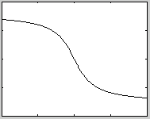
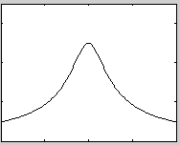
Example 4.1 (Cont’d):
Magnitude spectrum
Phase spectrum
0
0
0

Slide 17
Example 4.1 (Cont’d):
A complex spectrum, but for real signal x(t)
Conjugate:
Frequency reversal:
Conjugate and frequency reversal:

Slide 18
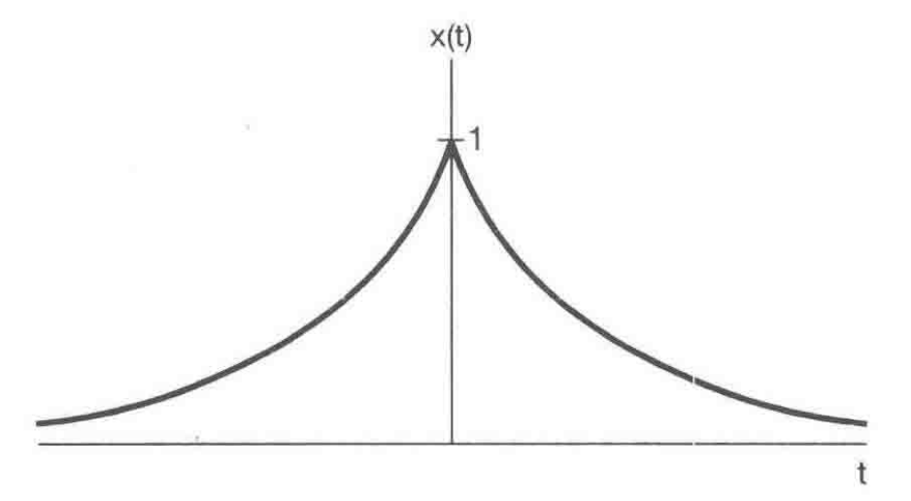
1. Representation of Aperiodic Signals: Continuous-Time Fourier Transform
Example 4.2:
Find FT of
Solution:
Note: this signal is real in time and has a real spectrum

Slide 19
1. Representation of Aperiodic Signals: Continuous-Time Fourier Transform
Example 4.3:
Find Fourier transform of
Solution:
Note that this signal does not meet the Dirichlet condition 3, finite discontinuity. However, it is a very important signal.
Note: in order to support the impulse behavior for the signal, it must have all frequency components included.

Slide 20
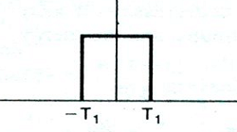
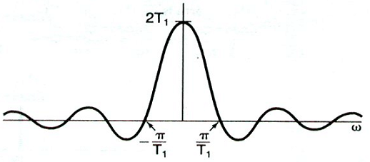
1. Representation of Aperiodic Signals: Continuous-Time Fourier Transform
Example 4.4:
Fourier transform of aperiodic square-wave
Solution:
Real signal and real spectrum
First zero-crossing frequency

Slide 21
Example 4.4 (Cont’d):
Note:
1. A perfect square-wave in time has infinite frequency components;
2. A perfect square-wave in time has a sharp transition in time-domain with an oscillating spectrum in the frequency-domain.
Example 4.5:
How about a perfect square-spectrum in the frequency-domain?

Slide 22
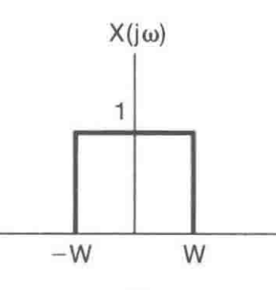
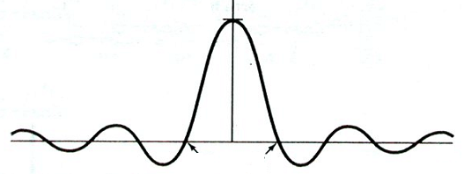
Example 4.5:
A perfect square spectrum
Solution:
Let
then

Slide 23
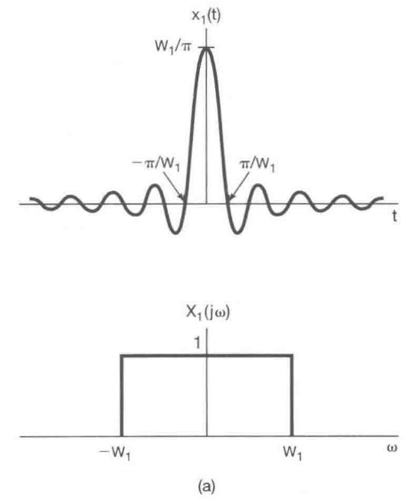
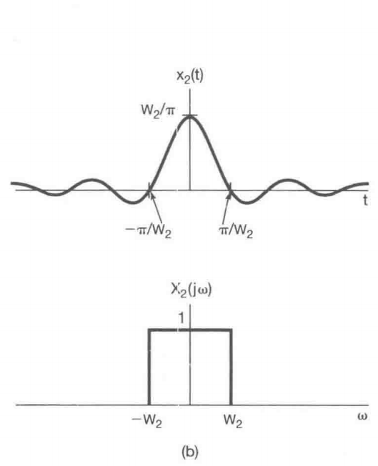
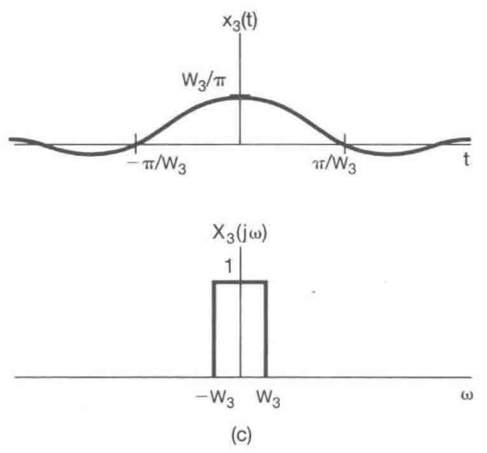
1. Representation of Aperiodic Signals: Continuous-Time Fourier Transform
Example 4.5:
Note: the wider the bandwidth, the narrower the pulse in time
the narrower the bandwidth, the wider the pulse in time

Slide 24
1. Representation of Aperiodic Signals: Continuous-Time Fourier Transform
Example 4.5:
Solution:
Note: A perfect ideal lowpass filter, but bad time-domain properties like non-causal, oscillation in time, low convergence rate
How to deal with these problems in practice:
cutoff in time, plus time delay for causality

Slide 25
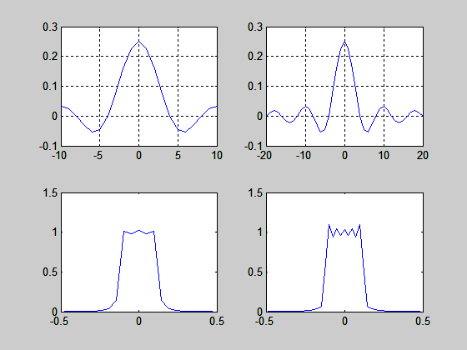
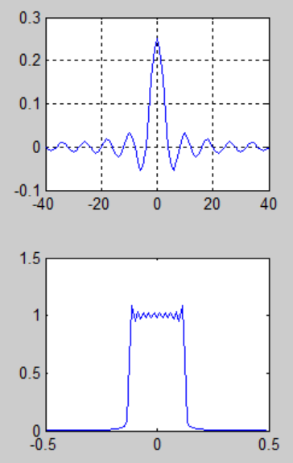
1. Representation of Aperiodic Signals: Continuous-Time Fourier Transform
Example 4.5:
cutoff in time

Slide 26
2. Fourier Transform for Periodic Signals (Ch.4.2)
Especially,
Periodic signal:
thus

Slide 27
2. Fourier Transform for Periodic Signals (Ch.4.2)
Example 4.7:
Another solution:
is a periodic signal with FS
Others are 0.

Slide 28
2. Fourier Transform for Periodic Signals (Ch.4.2)
Example 4.8:
An impulse train
1
…
…
-T
0
T
Solution: Example 3.8

Slide 29
Example 4.8 (Cont’d):
…
…
0
An impulse train in the time-domain gives an impulse train in the frequency-domain.

Slide 30
Group discussion:
1. For the following LTI system with
Find the output signal when the input signal is

Slide 31
3. Properties of Continuous-Time Fourier Transform (Ch.4.3)
Note: the same underlying principles behind FT and FS
plus, similar operations for both FT and FS, and thus similar properties for FT and FS.

Slide 32
3. Properties of Continuous-Time Fourier Transform (Ch.4.3)
1). Linearity:
If
then
For both periodic and aperiodic signals.
Example:
Find the Fourier Transform for
Solution: Aperiodic signal, no FS, but

Slide 33
3. Properties of Continuous-Time Fourier Transform (Ch.4.3)
2). Time Shifting:
The same spectrum except for a linear phase.
Proof:
Let

Slide 34
3. Properties of Continuous-Time Fourier Transform (Ch.4.3)
2). Time Shifting:
Another proof:
First
then
Note: similar to FS, two different ways to prove the FT properties

Slide 35
3. Properties of Continuous-Time Fourier Transform (Ch.4.3)
Example 4.9:
1.5
1
Find the Fourier transform of
1
2
3
4
+
=
1
0.5
1
2
3
4
1
2
3
4
Square-wave
and time shift of 2.5
+

Slide 36
3. Properties of Continuous-Time Fourier Transform (Ch.4.3)
3). Conjugation and Conjugate Symmetry:
(1) If
then
(2) If x(t) is real, then
and

Slide 37
3. Properties of Continuous-Time Fourier Transform (Ch.4.3)
Proof:
Not a standard synthesis equation

Slide 38
3. Properties of Continuous-Time Fourier Transform (Ch.4.3)
(3) If x(t) is real, and write
also write
Then,
For a real and even signal, its Fourier transform will be real; for a real and odd signal, its Fourier transform will be purely imaginary.
For example:

Slide 39
3. Properties of Continuous-Time Fourier Transform (Ch.4.3)
4). Differentiation and Integration:
(1) If
, then
Proof:
(2) If
then

Slide 40
3. Properties of Continuous-Time Fourier Transform (Ch.4.3)
Example 4.12:
x(t)
Find X( jω).
1
-1
1
-1
Here, we first find . What do you get?
g(t) =
1
-1
1
-1

Slide 41
Example 4.12 (Cont’d):
g(t) =
1
Black part: a square-wave
-1
1
-1
Red part: two unit impulses
with

Slide 42
Example 4.12 (Cont’d):
g(t) =
1
-1
1
-1
with

Slide 43
3. Properties of Continuous-Time Fourier Transform (Ch.4.3)
5). Time and Frequency Scaling:
Especially, for time reversal,
Proof:
a>0

Slide 44
3. Properties of Continuous-Time Fourier Transform (Ch.4.3)
5). Time and Frequency Scaling:
Proof:
a<0
Especially, for time reversal,

Slide 45
3. Properties of Continuous-Time Fourier Transform (Ch.4.3)
5). Time and Frequency Scaling:
Time compression
Frequency expansion
Time expansion
Frequency compression
Note: time compression, same waveform variation within shorter time, thus higher frequency components to support

Slide 46
Group discussion:
1. Given that , which one of the following is the correct FT for the signal
2. Given that , which one of the following is the correct signal for

Slide 47
3. Properties of Continuous-Time Fourier Transform (Ch.4.3)
6). Duality:
Proof:

Slide 48
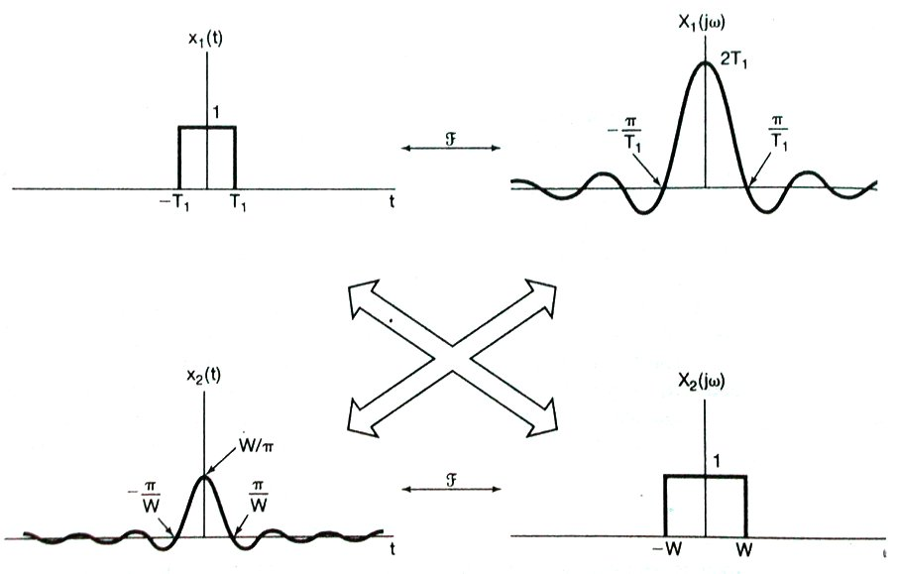
3. Properties of Continuous-Time Fourier Transform (Ch.4.3)

Slide 49
3. Properties of Continuous-Time Fourier Transform (Ch.4.3)
Example 4.13:
Find the FT of
From example 4.2,
By Duality,

Slide 50
3. Properties of Continuous-Time Fourier Transform (Ch.4.3)
6). Duality: other important results from duality
Periodic signal, only multiples of harmonic frequency
Aperiodic signal, any frequency shifting

Slide 51
3. Properties of Continuous-Time Fourier Transform (Ch.4.3)
7). Parseval’s Relation:
Aperiodic signal’s energy
Proof:

Slide 52
3. Properties of Continuous-Time Fourier Transform (Ch.4.3)
7). Parseval’s Relation:
Periodic signal, FS

Slide 53
3. Properties of Continuous-Time Fourier Transform (Ch.4.3)
Example 4.14: Evaluate the following:
for the two following signal spectrum
-1
1
-1
- 0.5
0.5
1
(a)
(b)
Note: the spectrum is given, the signal is known. determine the signal in time first?

Slide 54
Example 4.14 (Cont’d):
-1
1
-1
- 0.5
0.5
1
(a)
(b)
Solution:
(a)
(b)

Slide 55
Example 4.14 (Cont’d):
Let
then
Note that
(a)
D = 0 since
(b)
is odd.
-1
1
-1
- 0.5
0.5
1
(a)
(b)

Slide 56
Group discussion:
1. Compute the following integral
Which one of the choice is the correct result?

Slide 57
4. The Convolution Property (Ch.4.4)
Consider an LTI system:
x(t)
y(t)=x(t)*h(t)
h(t)
H(jω)
X(jω )
Y(jω)=X(jω)H(jω)
Since h(t) completely characterize an LTI system, so does H( jω). And H( jω) exists if h(t) satisfies the Dirichlet conditions.

Slide 58
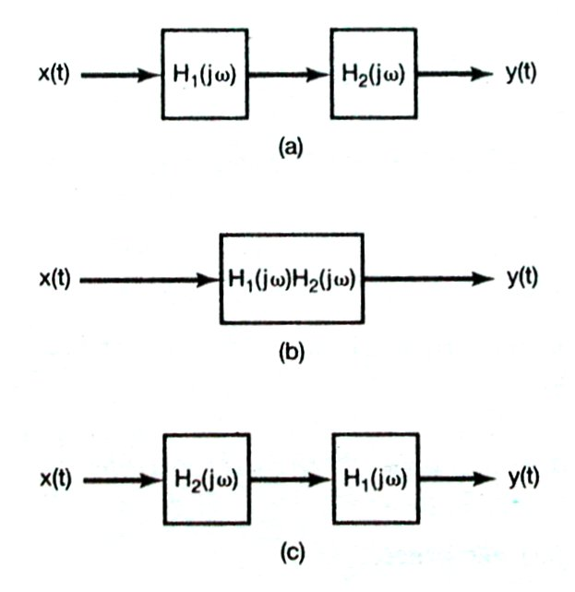
4. The Convolution Property (Ch.4.4)

Slide 59
4. The Convolution Property (Ch.4.4)
Proof 1:
A linear combination of frequency components as complex exponentials and an LTI system, with

Slide 60
4. The Convolution Property (Ch.4.4)
Proof 2:

Slide 61
4. The Convolution Property (Ch.4.4)
Example 4.15:
A system with
A simple LTI system.
To find its unit impulse response:
From
with time-shifting property

Slide 62
4. The Convolution Property (Ch.4.4)
Example 4.16:
An LTI system defined as
Find the frequency response of the system.

Slide 63
4. The Convolution Property (Ch.4.4)
Example 4.17:
--- integration
Note:

Slide 64
4. The Convolution Property (Ch.4.4)
Example 4.18:
a perfect low-pass filter
passband
stopband
Perfect frequency characteristics, but in time:
1. not causal
Why?
2. oscillating in time may not be desirable.
Reason: sharp transition in frequency

Slide 65
Example 4.19:
An LTI system defined as
with an input
Find its output.
Solution:
Convolution in time for

Slide 66
Example 4.19:
Solution:
Frequency multiplication,
if
Then, do inverse Fourier transform,
The key is how to do the expansion.

Slide 67
Example 4.19 (Cont’d):
If b = a,
Time convolution,

Slide 68
Example 4.19 (Cont’d):
In general,
See Problem Exercise 4.40
Example 4.20:
Please read the textbook yourself.

Slide 69
Group discussion:
1. Compute the following integral

Slide 70
Partial Fraction Expansion (Appendix)
Example:
To find the inverse Fourier transform of
expand Y(jω) as
Then use
for each term.

Slide 71
Partial Fraction Expansion (Appendix)
In general,
--- a ratio of polynomial
Question:
How to expand H(v) as a sum of terms like
For Fourier transform, replace v with jω.

Slide 72
Partial Fraction Expansion (Appendix)
1. If
, use polynomial division, we have
For Fourier transform,
……

Slide 73
Partial Fraction Expansion (Appendix)
2. proper rational function
Example:

Slide 74
Partial Fraction Expansion (Appendix)
Example:
Suppose p_{1 ,} p_{2 ,} p₃ are the roots of
then
1). If the three roots are not equal, that is p₁ ≠ p₂≠ p_{3 ,}
How to find A_{1 ,} A_{2 ,} A₃ ?

Slide 75
Partial Fraction Expansion (Appendix)
for any v.

Slide 76
Partial Fraction Expansion (Appendix)
Another way to find the coefficients:
Note

Slide 77
Partial Fraction Expansion (Appendix)
2). If p₁ = p₃≠ p_{2 ,}
both terms are necessary!

Slide 78
Partial Fraction Expansion (Appendix)
In-correct!

Slide 79
Partial Fraction Expansion (Appendix)
with

Slide 80
Partial Fraction Expansion (Appendix)
Example:

Slide 81
Partial Fraction Expansion (Appendix)
Example:

Slide 82
Partial Fraction Expansion (Appendix)
Example:
To find :

Slide 83
Group discussion:
1. Do polynomial division on
The result of G(v) is which one of the following choices.
2. Do partial fraction expansion to get the parameter A and B.

Slide 84
5. The Multiplication Property (Ch.4.5)
The multiplication (modulation) property:
s(t)
r(t)
p(t)
Duality property of Fourier transform
Non-LTI system

Slide 85
5. The Multiplication Property (Ch.4.5)
Proof: similar to convolution property

Slide 86
Proof:

Slide 87
5. The Multiplication Property (Ch.4.5)
Othogonality between complex exponential signals:
Harmonics:
In a general form:
Signals orthogonal to each other can be used as different dimensions for signal representation in general.

Slide 88
5. The Multiplication Property (Ch.4.5)
Example 4.21:
Find the spectrum for r(t) with
Solution with multiplication property:

Slide 89
5. The Multiplication Property (Ch.4.5)
Two copies of the original signal shifted to different frequencies.

Slide 90
5. The Multiplication Property (Ch.4.5)
Another solution：
Frequency shifting property:
Note: seen as a system with input s(t) and output r(t). New frequency components different from the input are generated at the output, thus, the system is not an LTI system

Slide 91
5. The Multiplication Property (Ch.4.5)
Example 4.22:
Note: should shift the whole spectrum.

Slide 92
Example 4.22 (Cont’d):
Recovering the original signal using a low-pass filter if no spectrum overlapping with large enough ω0.

Slide 93
Example 4.22 (Cont’d):
Another solution:

Slide 94
5. The Multiplication Property (Ch.4.5)
Example 4.23:
find its FT.
Solution: analysis equation? No way
Transform x(t) into some signals you know

Slide 95
Example 4.23 (Cont’d):
Note: an important example for FT computation with sinc() signals

Slide 96
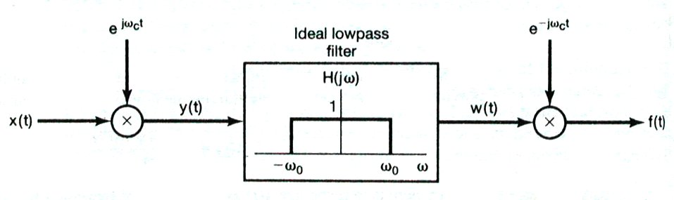
5. The Multiplication Property (Ch.4.5)
Frequency-Selective Filtering with Variable Center Frequency
A Bandpass Filter :

Slide 97
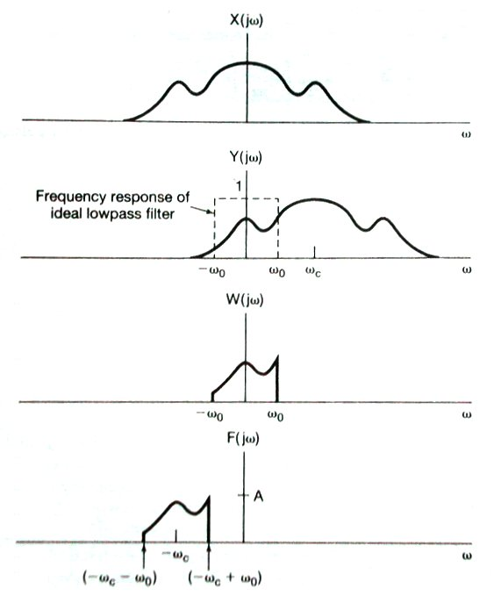
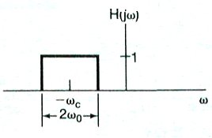
5. The Multiplication Property (Ch.4.5)
Equivalent to

Slide 98
Group discussion:
1. Prove the orthogonal property between the two signals:
2. Compute the following integral given the signal’s spectrum.
1
-1
1
The result is which one of the following choices.

Slide 99
6. Tables of Fourier Properties and of Basic Fourier Transform Pairs (Ch.4.6)
Table 4.1
Table 4.2

Slide 100
7. Systems Characterized by Linear Constant-Coefficient Differential Equations (Ch.4.7)
Time-domain description:
A casual LTI system if under initial rest.
If true, take Fourier transform:
Frequency response
Unit impulse response

Slide 101
7. Systems Characterized by Linear Constant-Coefficient Differential Equations (Ch.4.7)
Example 4.24:
Fourier transform:
Causal system and if a > 0, the system is stable.

Slide 102
7. Systems Characterized by Linear Constant-Coefficient Differential Equations (Ch.4.7)
Example 4.25:

Slide 103
Example 4.25 (Cont’d):
Causal and stable system.
Example 4.26:
The system from Example 4.25 with input
Find the output signal in time.

Slide 104
7. Systems Characterized by Linear Constant-Coefficient Differential Equations (Ch.4.7)
Example 4.26:

Slide 105
Example 4.26 (Cont’d):
Take

Slide 106
Example 4.26 (Cont’d):

Slide 107
Group discussion:
1. For the following system described by
under initial rest. Try to find the unit impulse response h(t) of the system.
2. Do partial fraction expansion to get the parameters A, B and C.

Slide 108
Extra Example 1:
In this textbook, no rigorous proof on this FT pair. Instead,
To get this FT pair, assume the time integral property is known:
To prove the time integral property, assume the FT pair is known:
Any other possible way to prove this important FT pair?

Slide 109
Extra Example 1:
No matter how small ω is!
Real and odd signal, purely imaginary spectrum

Slide 110
Extra Example 1:
Why incorrect?
For any non-zero a

Slide 111
Extra Example 2: Hilbert transform
Duality:
90-degree phase shifter
Any frequency components passing through this system will have its magnitude unchanged, but a 90-degree phase shifting.

Slide 112
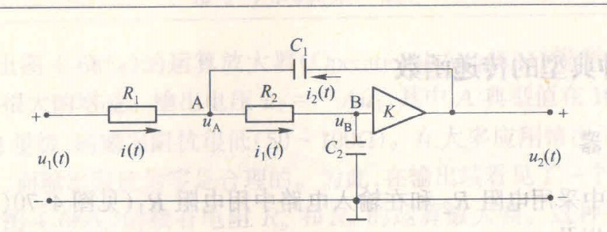
Extra Example 3: Circuit analysis using FT
Input
Output
Impedance:

Slide 113
Point A:
Point B:
An ideal amplifier:
Given the three equations, the three unknown voltage can be solved.

Slide 114
Extra Example 3: Circuit analysis using FT
Given that
Frequency response:
3dB bandwidth:
Unit impulse response:

Slide 115
Extra Example 4: properties of
An ideal low-pass filter type spectrum
1. Frequency-selective filtering:
2. Example 4.23, Compute the FT of
3. Prove
4. Compute the following integral given the signal’s spectrum.
1
-1
1

Slide 116
Other Examples:
1. Poisson formula: let
2. Compute

Slide 117
Group discussion:
1. Assume that , find
The result is which one of the following choices.
2. Let , prove that

Slide 118
Summary
1. Continuous-Time Fourier Transform of Aperiodic Signals
LTI system:
Convergence:
A stable system
Commonly-used FT pairs

Slide 119
Summary
2. Continuous-Time Fourier Transform of Periodic Signals
3. Properties of Continuous-Time Fourier transform

Slide 120
Summary
4. The Convolution Property:
Partial fraction expansion
5. The Multiplication Property:
6. Systems Characterized by Linear Constant-Coefficient Differential Equations: frequency analysis

